Slide 1
Durham University Palace Green Library Ancient Greeks Quiz!
Ready?

Slide 2
1. What are the three types
of column used in
Greek
temples?
(three
answers)
f. Doric
c. Corinthian
ε. Mycenaean
α. Ionic
δ. Minoan
β. Attic

Slide 3
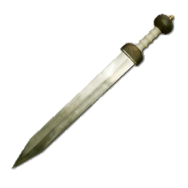
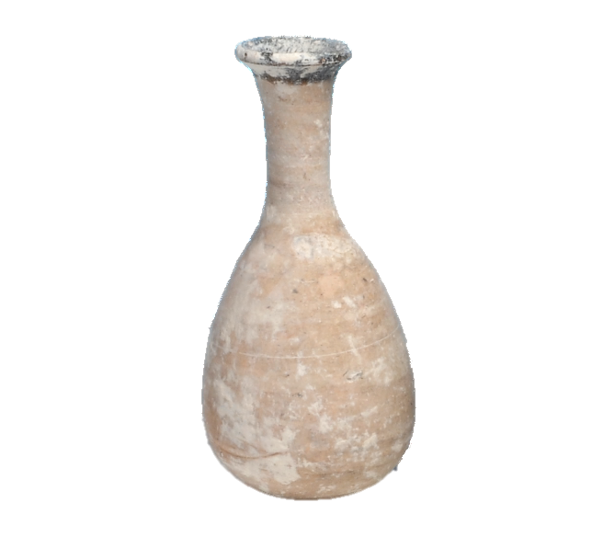
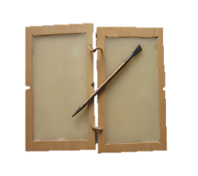
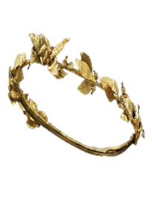
2. In the play ‘medea’, who has the final line?
α.
Jason
β.
Medea
c.
tutor
δ.
King
creon

Slide 4
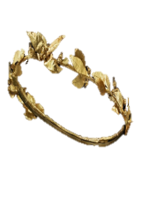
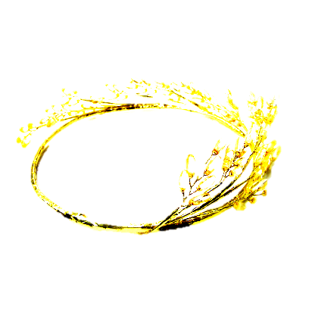
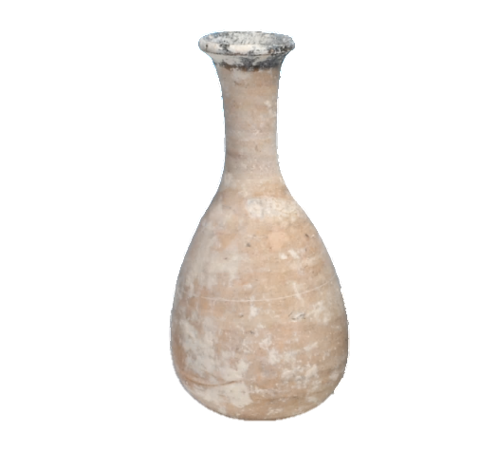
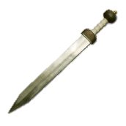
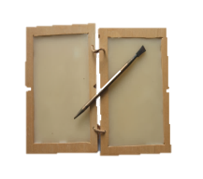
3. Which of the characters
in the play do experts say
have the tragic
downfall?
(Two answers)
α.
King creon
ε.
medea
β.
jason
δ.
Princess Glauce
c.
tutor

Slide 5
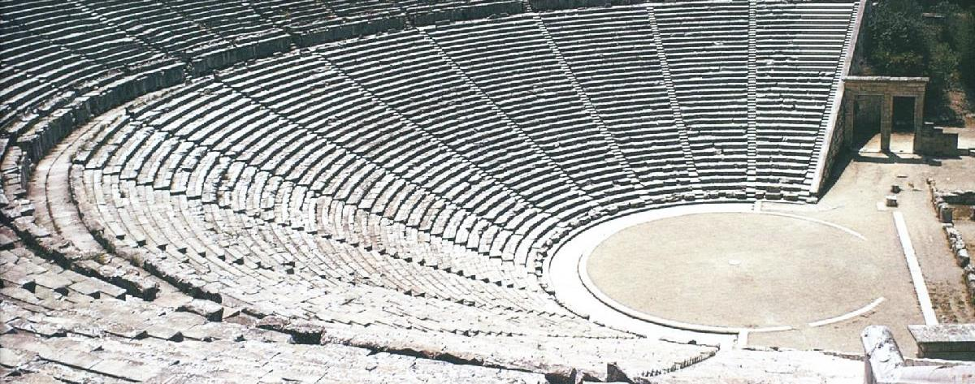
4. Why
did the Greeks not act death out on stage ?
(open
answer)

Slide 6
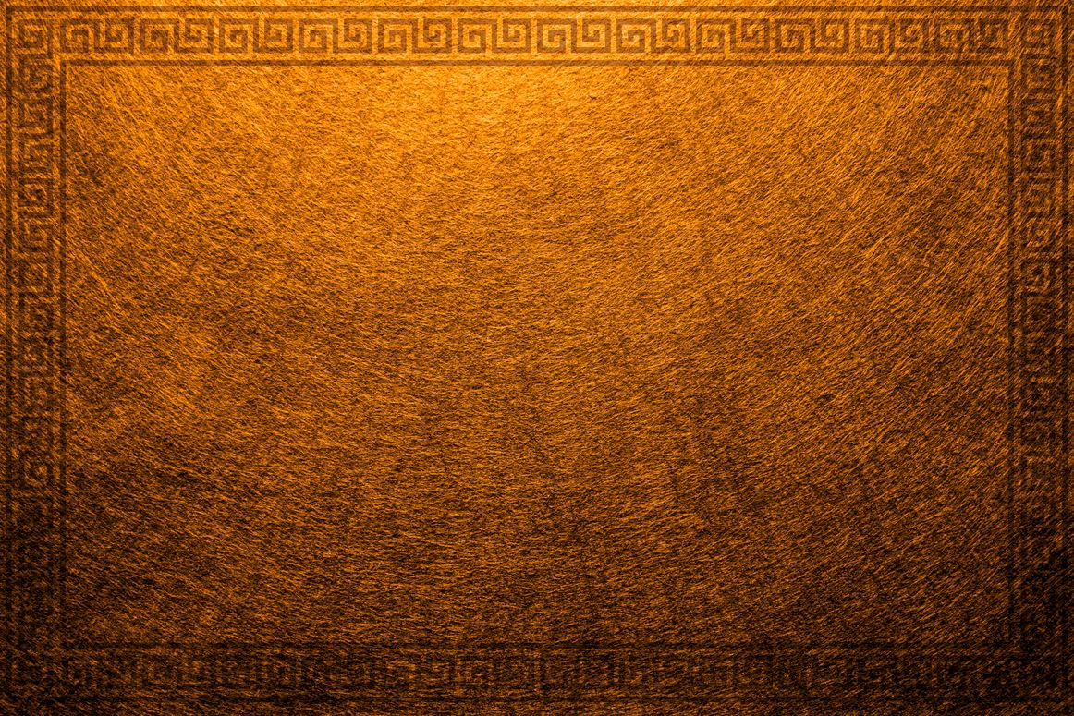
α.
wine
c.
beer
β.
Olive oil
δ.
water
5. What would you (usually) put in an amphora?

Slide 7
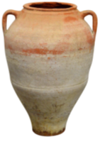
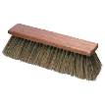
6. What would you do with an empty amphora?
α.
Keep
it
β.
Recycle it
c.
Clean
it
δ.
Throw
it away

Slide 8
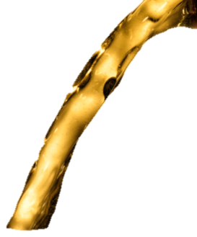
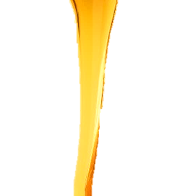
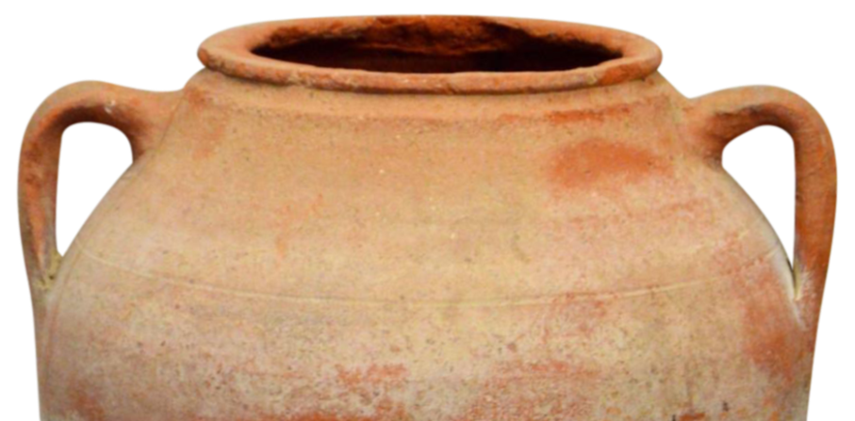
α.
Mixed with beer
c.
Mixed
with
water
β.
Mixed
with
honey
δ.
By
itself
7. How would the Greeks drink their wine?

Slide 9
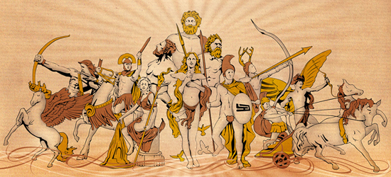
8. How would you say
thank you to the gods?
(Open answer
– only need one)

Slide 10
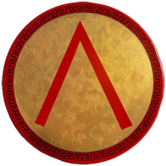
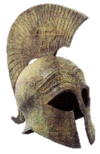
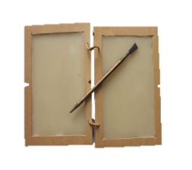
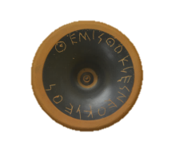
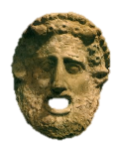
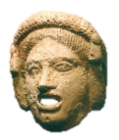
9. What did the Spartans let girls do that no other Greeks did?
α.
Vote
c.
Fight
β.
Go To School
δ.
Act On Stage

Slide 11
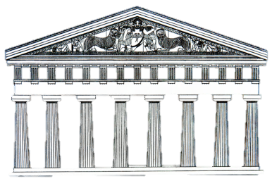
10. What is the base of a temple called?
α.
Entablature
c.
Column
β.
Stylobate
δ.
Pediment

Slide 12
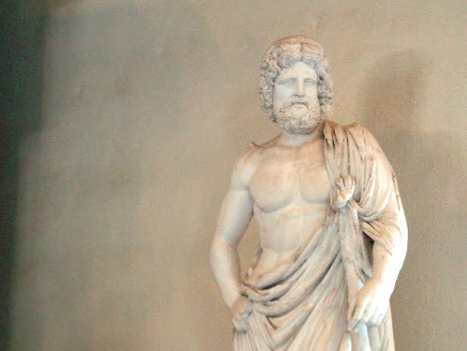
11. Name a Symbol of Asclepios, God of Healing.
(open answer – only need one)

Slide 13
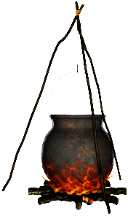
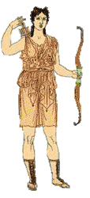
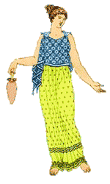
12. Why would the Greeks not have liked medea?
α.
She
was a witch
β.
She married Jason
c.
She
was a foreigner
δ.
She had
poor
fashion
sense

Slide 14
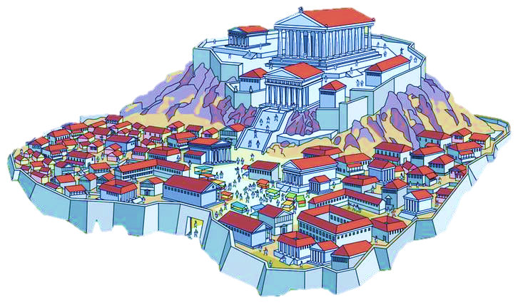
13. What was the Greek name for a city-state?
α.
Kylix
β.
Citizen
c.
Polis
δ.
Kingdom

Slide 15
14. What was
Dionysus the god
of? (Two answers)
α.
Theatre
β.
wine
c.
women
δ.
war

Slide 16
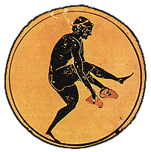
15. What event were the Olympic weights for?
α.
Pankration
c.
High jump
β.
Discus
δ.
Long jump

Slide 17
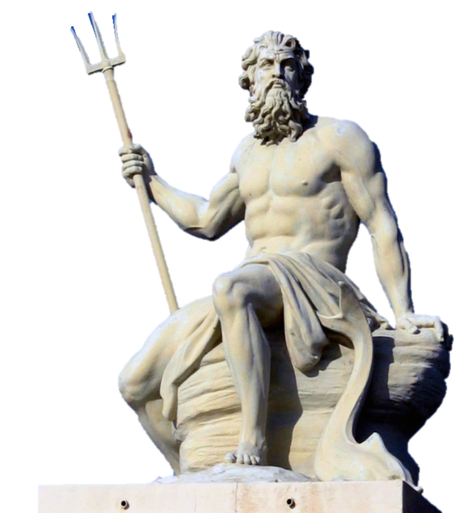
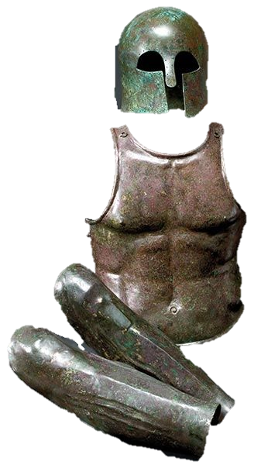
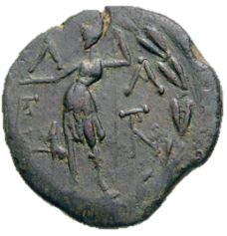
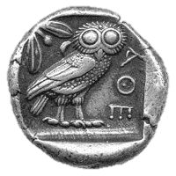
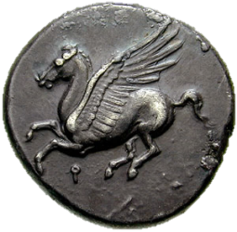
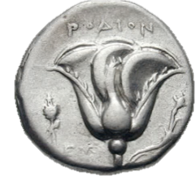
16. What would you get for winning the Olympic games?
α.
Nothing
c.
Money
β.
A full suit of armour
δ.
A statue
of you
as a god

Slide 18
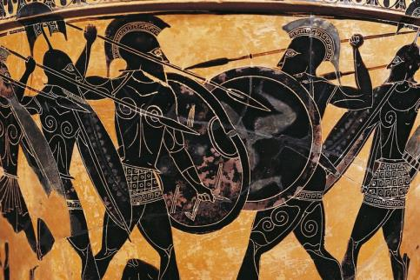
17. Who would buy your armour for war?
c.
you
α.
Your
king
β.
Your
city
δ.
Your enemy

Slide 19
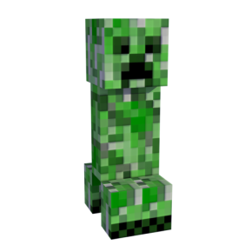
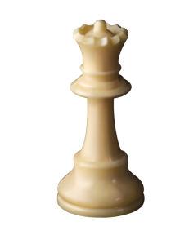
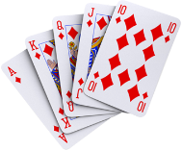
18. Name a game Greek children would play.
α.
Minecraft
c.
chess
β.
knucklebones
δ.
poker

Slide 20
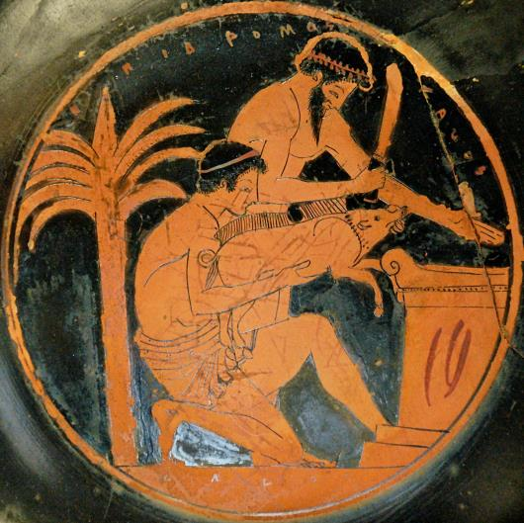
19. Is
this
pot
a
black
figure
pot
or
red
figure
pot?

Slide 21
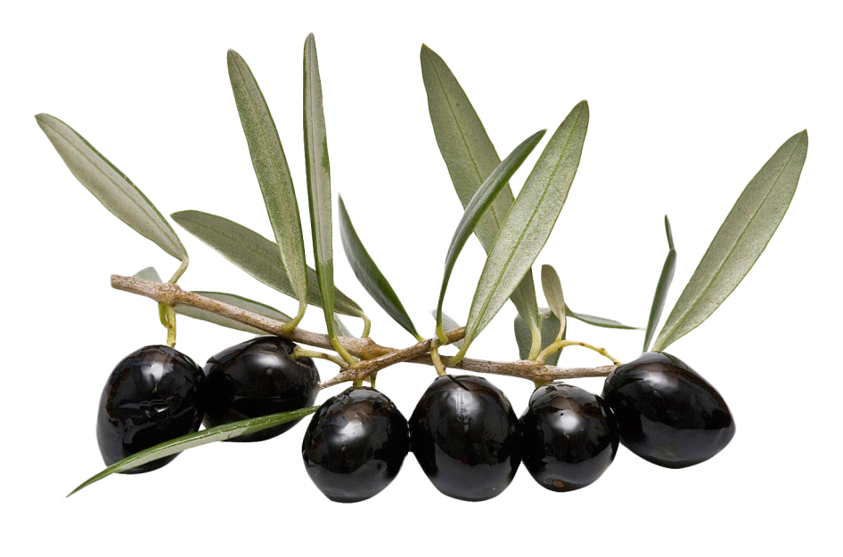
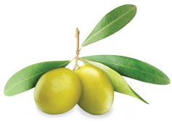
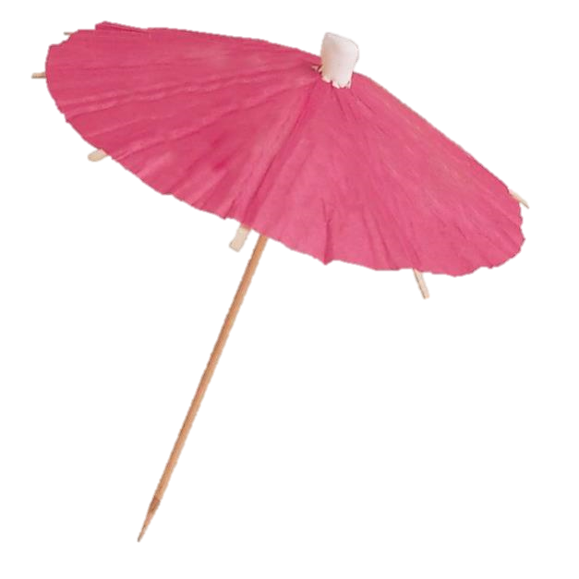
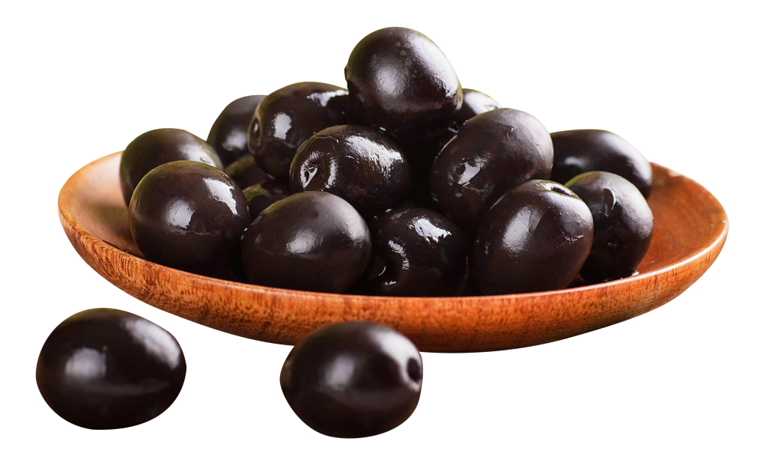
20. What would you put in a lekythos?
α.
Flowers
β.
food
c.
perfume
δ.
drinks

Slide 22
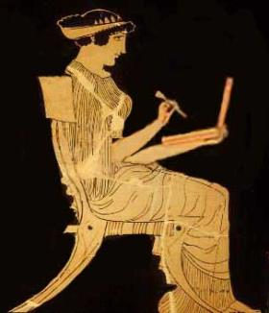
Answers!
Ready?

Slide 23
1. What are the three types
of column used in
Greek
temples?
(three
answers)
f. Doric
c. Corinthian
ε. Mycenaean
α. Ionic
δ. Minoan
β. Attic

Slide 24
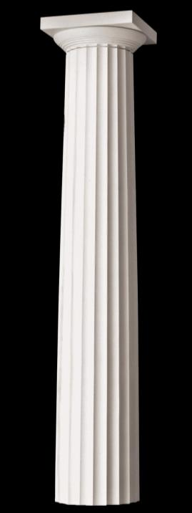
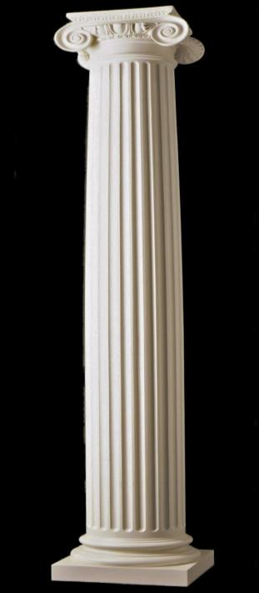
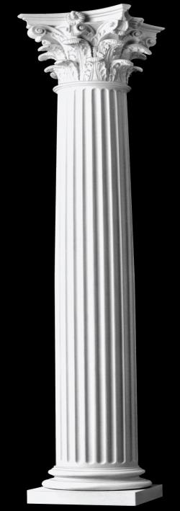
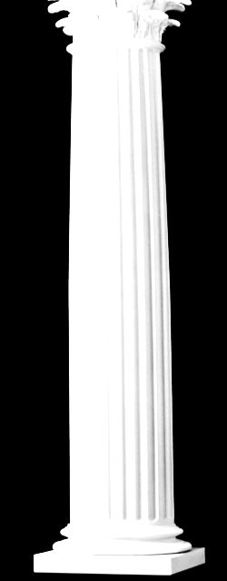
Corinthian
Ionic
Doric
I
II
III

Slide 25
2. In the play ‘medea’, who has the final line?
α.
Jason
β.
Medea
c.
tutor
δ.
King
creon

Slide 26
c. The Tutor finishes off the play lamenting
at what has happened.

Slide 27
3. Which of the characters
in the play do experts say
have the tragic
downfall?
(Two answers)
α.
King creon
ε.
medea
β.
jason
δ.
Princess Glauce
c.
tutor

Slide 28
β. and ε. – Arguably it’s Jason and Medea, as they lose both their children and their marriage to each other.
However, it does not end particularly well for
any of the characters.

Slide 29
4. Why
did the Greeks not act death out on stage ?
(open
answer)

Slide 30
In short, Dionysius, god of theatre, is a cheerful god, and acting out death in front of him (remember he’s watching the play too) would be disrespectful. there’s another idea that he (and the other gods) might think that you have actually died, and drag you soul to the underworld.

Slide 31
α.
wine
c.
beer
β.
Olive oil
δ.
water
5. What would you (usually) put in an amphora?

Slide 32
α. Wine – although you
could put the others
in an amphora,
it was usually wine.

Slide 33
6. What would you do with an empty amphora?
α.
Keep
it
β.
Recycle it
c.
Clean
it
δ.
Throw
it away

Slide 34
δ. throw it away
– amphora were so cheap they would often be thrown away rather then kept, although some were reused as urinals!

Slide 35
α.
Mixed with beer
c.
Mixed
with
water
β.
Mixed
with
honey
δ.
By
itself
7. How would the Greeks drink their wine?

Slide 36
c. Mixed with water
– some Greeks would take this very seriously – it was part of being a Greek. Otherwise, you would be like a barbarian, the most un-Greek kind of person imaginable.

Slide 37
8. How would you say
thank you to the gods?
(Open answer
– only need one)

Slide 38
Any of the following –
money,
votive offerings,
animal sacrifice,
discus or other sporting equipment,
weapons and armour.
Basically, any nice gift
to keep the gods happy!

Slide 39
9. What did the Spartans let girls do that no other Greeks did?
α.
Vote
c.
Fight
β.
Go To School
δ.
Act On Stage

Slide 40
β. Go to school –
Other Greeks thought that this was very strange, as they thought that girls needed to know was how to look after a home. Spartan women also had more rights, in some way – they could own their own property and even (shock, Horror!) tell a man off in public without penalty. Spartans believed that the fitter and healthier their women were, the healthier their children would be,

Slide 41
10. What is the base of a temple called?
α.
Entablature
c.
Column
β.
Stylobate
δ.
Pediment

Slide 42
δ. pediment–
A Tall, stepped platform to have the temples on, so that it looked
more impressive, basically!

Slide 43
11. Name a Symbol of Asclepios, God of Healing.
(open answer – only need one)

Slide 44
Can be a dog, a snake, or a staff. The dog relates to sacred dogs used in some shrines to lick wounds and sores. the snake may refer to the shedding of skin and healing anew. the staff may refer to doctors usually being older people with experience.

Slide 45
12. Why would the Greeks not have liked medea?
α.
She
was a witch
β.
She married Jason
c.
She
was a foreigner
δ.
She had
poor
fashion
sense

Slide 46
α. and c. – She was a witch and a foreigner – she was not only a witch (and any woman with power was scary to the Ancient Greeks!), she was also from Colchis, on the eastern coast of the Black Sea. Although technically from a Greek kingdom colony/kingdom, she would be seen as foreign by Greeks from the mainland.

Slide 47
13. What was the Greek name for a city-state?
α.
Kylix
β.
Citizen
c.
Polis
δ.
Kingdom

Slide 48
c. Polis –
This would often feature on the end of city names. and is still sometimes used today.
α.
Kylix
β.
Citizen
c.
Polis
δ.
Kingdom

Slide 49
14. What was
Dionysus the god
of? (Two answers)
α.
Theatre
β.
wine
c.
women
δ.
war

Slide 50
α and β - Theatre and wine – Dionysus was often portrayed as drunk, and among vines And grapes, encouraging mortals to keep drinking. Plays (Especially in Athens during the Dionysia Festival) would be performed in his honour.

Slide 51
15. What event were the Olympic weights for?
α.
Pankration
c.
High jump
β.
Discus
δ.
Long jump

Slide 52
δ. Long jump -
you would swing the weights
forward and backward before
jumping from a stand still – the weights would help carry you
forward as you jumped.

Slide 53
16. What would you get for winning the Olympic games?
α.
Nothing
c.
Money
β.
A full suit of armour
δ.
A statue
of you
as a god

Slide 54
δ. A statue of you as a god -
This would be left near the temple of Zeus in the centre of the Olympic complex, as an example to other athletes. Money, armour, fame, and palaces would all follow, but when you got back home.

Slide 55
17. Who would buy your armour for war?
c.
you
α.
Your
king
β.
Your
city
δ.
Your enemy

Slide 56
c. you-
Greek cities would not normally have an army,
but could raise militia when they had to fight. Every citizen (men only,
and no foreigners or
slaves) would be expected
to provide their own kit. The richest would fight at the front of a block of troops, where they would be seen to be bravely defending their city. The poor were shoved to the back.

Slide 57
18. Name a game Greek children would play.
α.
Minecraft
c.
chess
β.
knucklebones
δ.
poker

Slide 58
β. Knucklebones –
THIS WOULD HAVE BEEN PLAYED DURING THE GALLERY TRAIL YOUR GROUP DID UPSTAIRS! Other toys would include spinning tops and dolls.

Slide 59
19. Is
this
pot
a
black
figure
pot
or
red
figure
pot?

Slide 60
Red Figure –
The people
on the
pot are
coloured
red/orange.
This would be
harder to make than black figure pottery, where you would just paint the scene out. To make red figure
pottery, you needed
to paint the background and
the details in.

Slide 61
20. What would you put in a lekythos?
α.
Flowers
β.
food
c.
perfume
δ.
drinks

Slide 62
c. Perfume – smelling good was very important to the Greeks, and perfume was a must before any big event. Smelling
bad was
what barbarians did!

Slide 63
Well done, explorers!

