Slide 1

Cross-Language Dynamics: Reshaping Community
Transnational Strand
OWRI project launch, Manchester, 10 October 2016

Slide 2
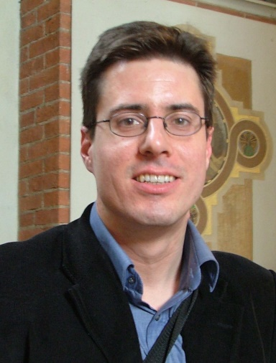

Transnational Strand
A. Byford (MLAC) &
A. Ehteshami (SGIA)
exploring the dynamics of political, social and cultural interactions across diversely defined ‘communities’ that share a single language, yet are dispersed across multiple national states and cultures
Russian, Arabic, Spanish, etc.

Slide 3
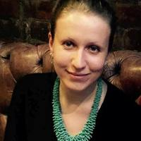
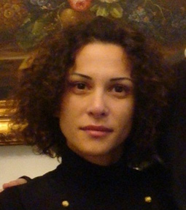
Durham MLAC’s Transnational Strand Co-Is
The Language Border: Russian in Former Soviet Union Migration (P. Kliuchnikova)
The Transnationalism of Post-Soviet Cinemas (D. Radunović)
That Disease: Cancer in the Arab World (A. Hamdar)
Atlantic Insularities: Languages of Exorbitance in Island Cultures (F.-J. Hernández Adrián)

Slide 4




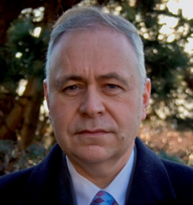
International Broadcasting and the Russian-speaking Community (S. Hutchings)
‘Global Russians’: Transnational Russophone Networks in the UK (L. Ryazanova-Clarke)
Transnational Theatre: 'New Drama' in the Post-Soviet Russophone Space (J. Curtis)
Can the Subaltern Speak?: Remapping World Cinemas in the Digital Age (P. Cooke)

Slide 5
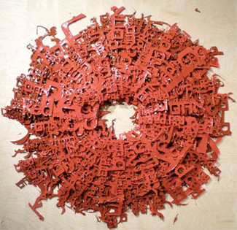

Durham MLAC’s further activities
Centre for Humanities Innovation: History of Innovation in the Humanities
(A. Byford & C. Caruso)
Centre for Intercultural Mediation: Translation Repositioned: Commodity, Identity, Displacement
(M. Schachter & S. Tyulenev)
Institute of Advanced Studies: Comparative Multiculturalism
(International JRF - to be recruited)

Slide 6


Beyond research
Curriculum Development: Transnational Russian Studies
(LUP Transnational Modern Languages Series)
Local Outreach: promoting the uptake of foreign languages in schools in the North East of England
National Impact: rEvolution@100: World Cinema festival (Newcastle, 2017)
International Impact: A. Hamdar’s Beirut performance

Slide 7

Transnational Language, Transient identities, and the Crisis of the State in the Arab World
exploring the transnational circulation of competing narratives of identity, history and community that are forming in the Arab world around the phenomenon of ‘radical Islam’.
IS (Daesh) as a key case study: scrutinising its narrative, identifying its intellectual roots, capturing responses to it in the Arab region, exploring its place in Arab politics.
studying the language and rhetoric of Arabic social media produced in response to Daesh’s own famed social media presence.

Slide 8
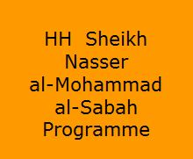
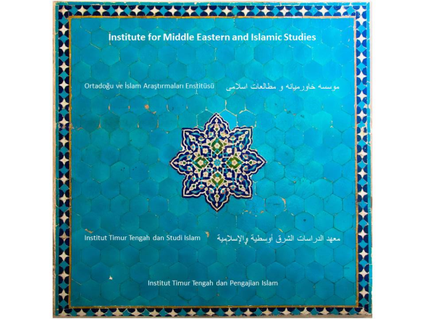



Partners
Durham SGIA
PDRA (to be appointed in Jan 2017)
PhD (appointed in Oct 2017; fully funded by al-Sabah programme)
IMEIS

