Slide 1



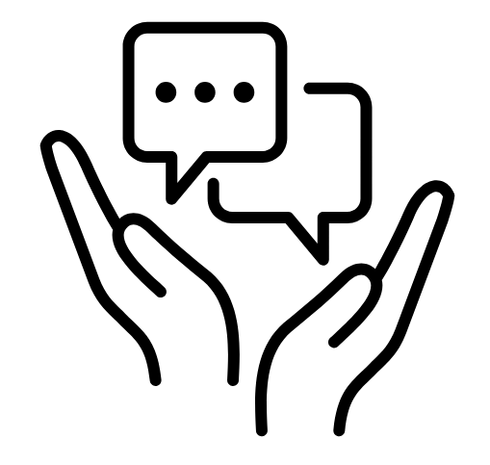

Principles of Respectful Engagement
We want everyone to feel welcomed and able to contribute to this activity. The following are our shared principles of respectful engagement.
Inclusive Communication
Communicate with respect and consideration for all, recognising and valuing people’s diverse
backgrounds, experiences and perspectives.
Recognise the importance of pronouncing names correctly and make a genuine effort to learn and
use accurate pronunciations.
Engagement with Integrity
Challenge respectfully, ensuring that we challenge the idea and not the individual.
Contribute to the discussion with a constructive, open and positive approach.​
Equitable Participation
Foster an environment where all participants feel empowered to contribute and engage in the discussion.
Recognise that participation can take many forms, including observation and reflection.
Supportive Engagement
Share your pronouns if you are comfortable to do so.
Be kind to each other, listen with empathy and be mindful of impact.
Take a step back if you need to and rejoin if you’re able to.
Notes:
Icon source: Noun Project website (https://thenounproject.com/)

